Slide 1
TWO TANK INTERACTING SYSTEM
Presented by
Shubham Priyadarshi
2023CHB1081

Slide 2
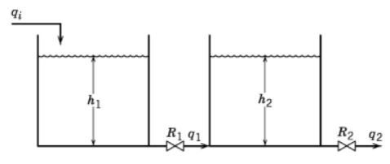
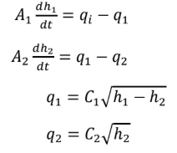
PROBLEM
Two liquid surge tanks are connected in series so that the outflow from Tank 1 becomes the inflow to Tank 2.
The inlet flowrate to Tank 1 is denoted by qiq_iqi​.
The outlet flowrate from Tank 1, which is also the inflow to Tank 2, is denoted by q1q_1q1​.
The outlet flowrate from Tank 2 is denoted by q2q_2q2​.
The system aims to study the dynamic behavior of the liquid level in Tank 2 when a step change is introduced in the inlet flowrate qi​ to Tank 1.
Dynamic model equations of the system:

Slide 3
OBJECTIVES
To identify process parameters, manipulated, disturbance, and controlled variables.
To obtain the steady-state of the nonlinear system.
To linearize the nonlinear model around steady-state to find matrices A, B, C, D.
To develop transfer functions G(s)/qi and G(s)/q2.
To compare linear and nonlinear model responses for insulin step inputs.
To perform stability analysis using poles of the transfer functions

Slide 4
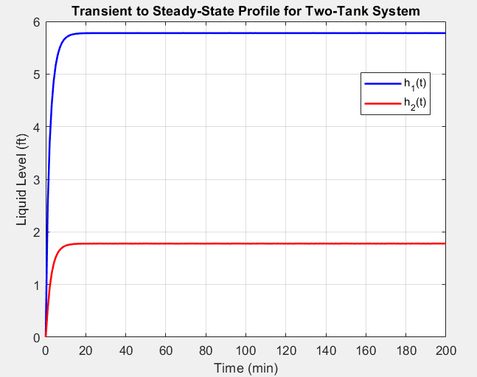
Steady State Result
Ran the simulation until the system variables stabilized at their steady-state values.
Steady state levels:
h1_ss = 5.778 ft
h2_ss = 1.778 ft

Slide 5
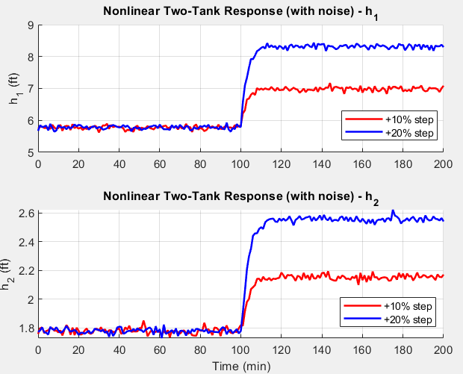
Non-Linear Model and Simulation
Given a step change (+10%, +20%) was applied to the input variable.
Nonlinear Step +10%:
h1: Kp = 0.7442 ft/(cfm)
Tau = 3.00 min
h2: Kp = 0.2400 ft/(cfm)
Tau = 4.00 min
Nonlinear Step +20%:
h1: Kp = 0.7941 ft/(cfm)
Tau = 3.00 min
h2: Kp = 0.2446 ft/(cfm)
Tau = 4.00 min

Slide 6
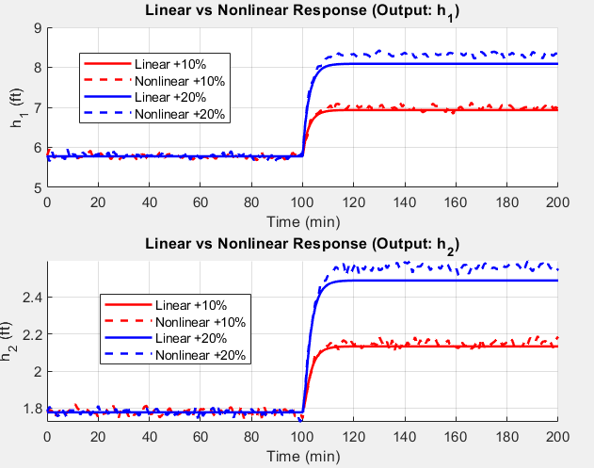
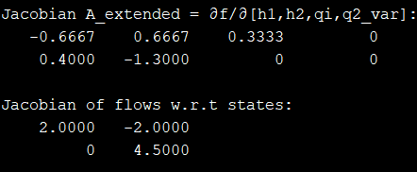
Linearization & Model Comparison
Uses Two approaches for linearization
Approach 1: Single Input (qi)
Here, q2 is treated as independent
variable

Slide 7
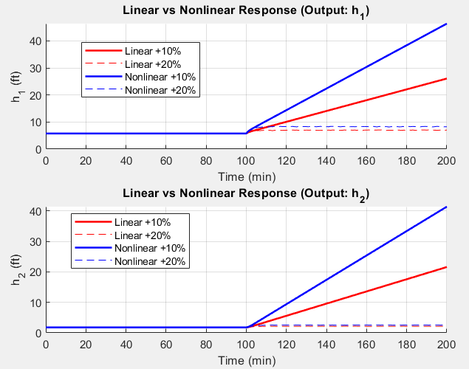
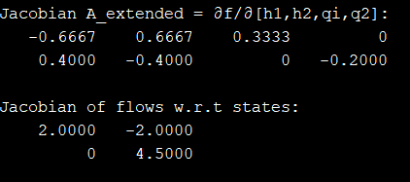
Linearization & Model Comparison
2. Approach 2:
Two inputs qi and q2

Slide 8
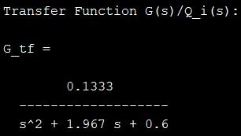
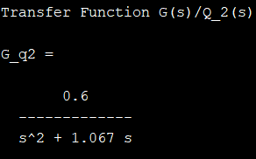
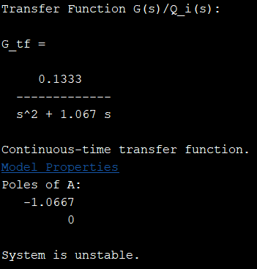
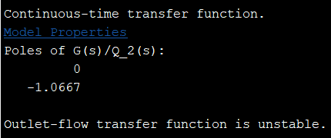
Transfer Function Model
Transfer Functions for
Approach 1
Poles of A: -0.3776, -1.5891
System is stable.
2. Approach 2

Slide 9
Conclusion
The system exhibits second-order dynamics, as confirmed by the form of the characteristic polynomial obtained from the transfer function models.
The derived transfer functions successfully capture the dynamic interaction between the inlet flow rate and the liquid levels in both tanks, offering a clear picture of the process behavior.
These transfer functions provide a comprehensive input–output representation, making them highly suitable for controller design, system identification, and dynamic analysis.
The linearized state-space models show excellent agreement with the nonlinear system responses near the operating point, validating the accuracy and applicability of the linear approximation.
All poles for both approaches are real and non-positive, confirming system stability for approach 1.
But, for approach 2 one pole is zero so system is unstable.
Overall, the modeling and linearization results demonstrate that the two-tank system is stable, well-behaved, and physically consistent, and the developed models serve as a reliable basis for future control strategy development and performance evaluation.

